Slide 1
THE LIFE OF CHRIST
PART 7

Slide 2
Matthew 2:1 Now after Jesus was born in Bethlehem of Judea in the days of Herod the king, behold, wise men from the East came to Jerusalem, ² saying, "Where is He who has been born King of the Jews? For we have seen His star in the East and have come to worship Him."

Slide 3
“It is better to be Herod’s pig than to be his son” (huios).

Slide 4
Notice how BDAG defines wise men:
wise man and priest, who was expert in astrology, interpretation of dreams and various other occult arts

Slide 5
According to Nelson’s Bible dictionary:
The Greek Historian Herodotus, writing in the fifth century B.C., identified the Magi as a caste of Medes who had a priestly function in the Persian Empire. In the Book of Daniel the “astrologers” (magoi) are grouped with the magicians, sorcerers, and Chaldeans as advisers to the court of Babylon with responsibility for interpreting dreams.

Slide 6
Matthew 2:3 When Herod the king heard this, he was troubled, and all Jerusalem with him. ⁴ And when he had gathered all the chief priests and scribes of the people together, he inquired of them where the Christ was to be born. ⁵ So they said to him, "In Bethlehem of Judea, for thus it is written by the prophet: ⁶ 'But you, Bethlehem, in the land of Judah, Are not the least among the rulers of Judah; For out of you shall come a Ruler Who will shepherd My people Israel.' "

Slide 7
Matthew 2:7 Then Herod, when he had secretly called the wise men, determined from them what time the star appeared. ⁸ And he sent them to Bethlehem and said, "Go and search carefully for the young Child, and when you have found Him, bring back word to me, that I may come and worship Him also." ⁹ When they heard the king, they departed; and behold, the star which they had seen in the East went before them, till it came and stood over where the young Child was.

Slide 8
Matthew 2:10 When they saw the star, they rejoiced with exceedingly great joy. ¹¹ And when they had come into the house, they saw the young Child with Mary His mother, and fell down and worshiped Him. And when they had opened their treasures, they presented gifts to Him: gold, frankincense, and myrrh. ¹² Then, being divinely warned in a dream that they should not return to Herod, they departed for their own country another way.

Slide 9
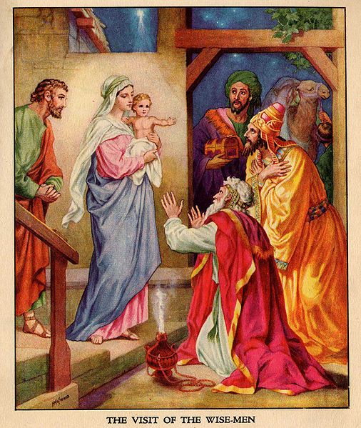

Slide 10
Matthew 2:13 Now when they had departed, behold, an angel of the Lord appeared to Joseph in a dream, saying, "Arise, take the young Child and His mother, flee to Egypt, and stay there until I bring you word; for Herod will seek the young Child to destroy Him." ¹⁴ When he arose, he took the young Child and His mother by night and departed for Egypt, ¹⁵ and was there until the death of Herod, that it might be fulfilled which was spoken by the Lord through the prophet, saying, "Out of Egypt I called My Son."

Slide 11
Matthew 2:16 Then Herod, when he saw that he was deceived by the wise men, was exceedingly angry; and he sent forth and put to death all the male children who were in Bethlehem and in all its districts, from two years old and under, according to the time which he had determined from the wise men. ¹⁷ Then was fulfilled what was spoken by Jeremiah the prophet, saying: ¹⁸ "A voice was heard in Ramah, Lamentation, weeping, and great mourning, Rachel weeping for her children, Refusing to be comforted, Because they are no more."

Slide 12
Matthew 2:19 But when Herod was dead, behold, an angel of the Lord appeared in a dream to Joseph in Egypt, ²⁰ saying, "Arise, take the young Child and His mother, and go to the land of Israel, for those who sought the young Child's life are dead." ²¹ Then he arose, took the young Child and His mother, and came into the land of Israel. ²² But when he heard that Archelaus was reigning over Judea instead of his father Herod, he was afraid to go there. And being warned by God in a dream, he turned aside into the region of Galilee. ²³ And he came and dwelt in a city called Nazareth, that it might be fulfilled which was spoken by the prophets, "He shall be called a Nazarene."

Slide 13
Notice that the plural is used here of “the prophets”; no particular prophet had spoken of Jesus dwelling in Nazareth. It is thought that Matthew quotes the general sentiment of the prophets, that he is giving the equivalent sentiment of the prophets, that he is giving the equivalent of their language and not the exact language. Many of these prophets had predicted the humble life of Jesus; this is expressed in the proverbial statement that he should be called a Nazarene.” “A Nazarene” is a term of contempt. (John 1:46; 7:52) The very name Nazareth suggested insignificance; in the Hebrew it meant to sprout or shoot. This name is prophetically given to the Messiah. (Isa. 11:1)

Slide 14
The figure of the tree is continued by Isaiah and is applied to the Jewish state. As David sprang from the humble family of Jesse, so the Messiah, the second David, shall arise out of great humiliation. The fact that Jesus grew up at Nazareth was sufficient reason for his being despised; he was not a lofty branch on the summit of a stately tree; not a recognized and honored son of the royal house of David, now fallen, but an insignificant “sprout” from the roots Jesse; a Nazarene, of an insignificant village (Gospel Advocate .P. 63).

Slide 15
Luke 2:41 His parents went to Jerusalem every year at the Feast of the Passover.

Slide 16
Deuteronomy 6:6 And these words which I command you today shall be in your heart. ⁷ "You shall teach them diligently to your children, and shall talk of them when you sit in your house, when you walk by the way, when you lie down, and when you rise up. ⁸ "You shall bind them as a sign on your hand, and they shall be as frontlets between your eyes. ⁹ "You shall write them on the doorposts of your house and on your gates.

Slide 17
Luke 2:42 And when He was twelve years old, they went up to Jerusalem according to the custom of the feast. ⁴³ When they had finished the days, as they returned, the Boy Jesus lingered behind in Jerusalem. And Joseph and His mother did not know it; ⁴⁴ but supposing Him to have been in the company, they went a day's journey, and sought Him among their relatives and acquaintances. ⁴⁵ So when they did not find Him, they returned to Jerusalem, seeking Him.

Slide 18
The feast of unlevened bread followed for seven days (Lev. 23:4-8)

Slide 19
Luke 2:46 Now so it was that after three days they found Him in the temple, sitting in the midst of the teachers, both listening to them and asking them questions. ⁴⁷ And all who heard Him were astonished at His understanding and answers. ⁴⁸ So when they saw Him, they were amazed; and His mother said to Him, "Son, why have You done this to us? Look, Your father and I have sought You anxiously." ⁴⁹ And He said to them, "Why did you seek Me? Did you not know that I must be about My Father's business?" ⁵⁰ But they did not understand the statement which He spoke to them.

Slide 20
Luke 2:51 Then He went down with them and came to Nazareth, and was subject to them, but His mother kept all these things in her heart. ⁵² And Jesus increased in wisdom and stature, and in favor with God and men.

